Slide 1

Malayalam to Telugu Translation
NLP Project - Project Proposal & Literature Review
Student Name: Pranav Deep. I
Course Instructor: Dr. Himangshu Sarma

Slide 2
What is Machine Translation?
Machine translation (MT) is the task to translate a text from a source language to its counterpart in a target language
Types of Machine Translation:
Statistical Machine Translation or SMT : Misses context
Rule-based Machine Translation or RBMT : Needs broad editing
Hybrid Machine Translation or HMT : Large scale manual translation needed
Neural Machine Translation or NMT : Uses Neural Networks
Acknowledgement : www.analyticssteps.com
Notes:
Task of machine translation is to change one source language word succession into another objective language word grouping which is semantically the same
Source - https://www.analyticssteps.com/blogs/4-types-machine-translation-nlp

Slide 3
Neural Machine Translation (NMT)
NMT relies upon neural network models (based on the human brain) to build statistical models with the end goal of translation
Advantages:
It gives a solitary system that can be prepared to unravel the source and target text
Subsequently, it doesn't rely upon specific systems that are regular to other machine translation systems, particularly SMT
Acknowledgement : www.analyticssteps.com

Slide 4
Challenges
There are many challenging aspects of Machine Translation:
The large variety of languages, alphabets and grammars
The task to translate a sequence (a sentence for example) to a sequence is harder for a computer than working with numbers only
There is no one correct answer
e.g.: translating from a language without gender-dependent pronouns, he and she can be the same)
Telugu, Malayalam are categorized as low resourced languages

Slide 5
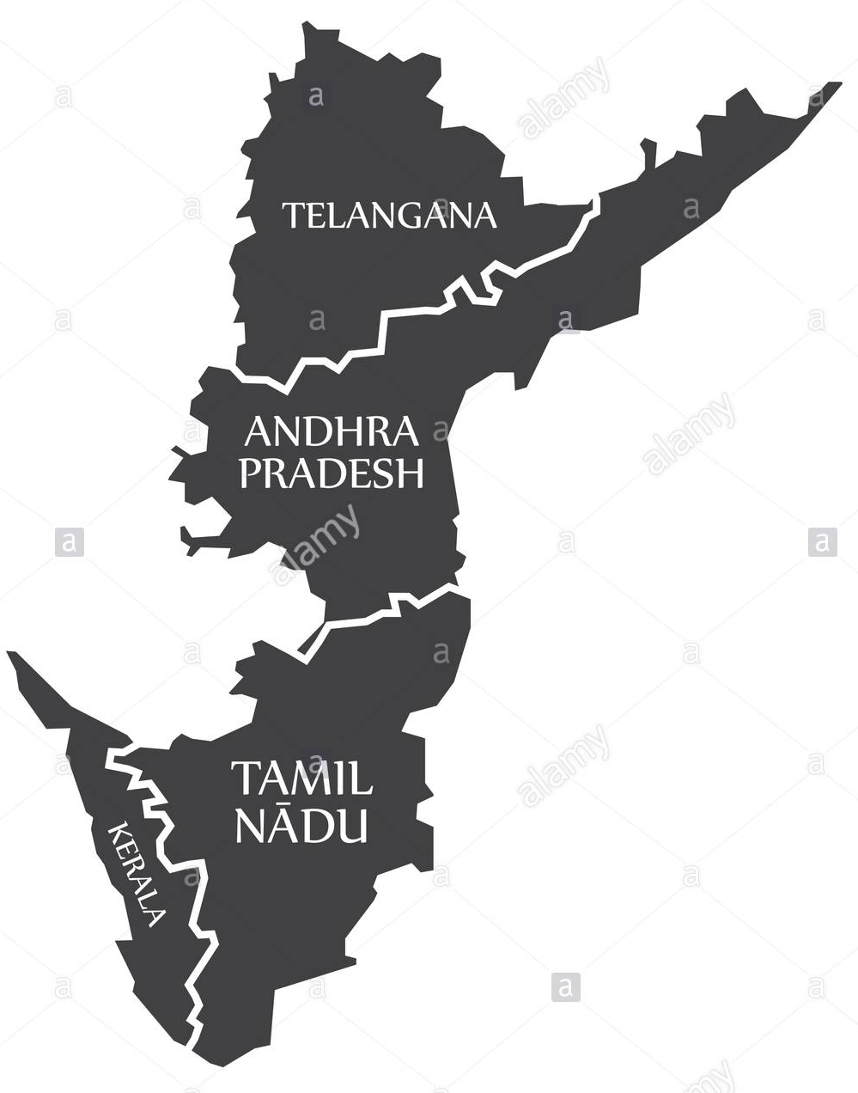
Motivation
Nationalism : Dravidian language speakers contribute to
220-230 million
population, but we’re still being categorized as
“Low Resource”
(On a lighter note).......
To understand if my Malayali friends are cursing me

Slide 6
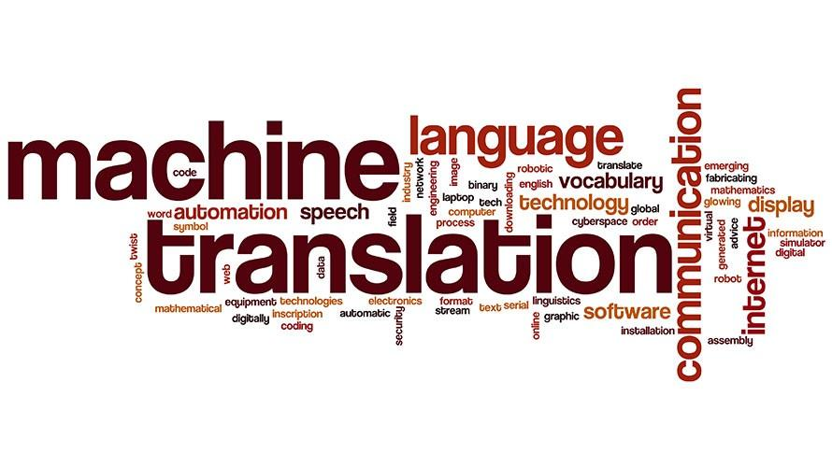
Datasets[8]
Press Information Bureau Corpus
PM Mann ki baat data set
MultiIndicMT Dataset

Slide 7

PIB Corpus
Press Information Bureau(PIB) is an Indian government agency responsible for communications to media (across 12 Indian languages).
These translations can be considered as expert translations and are fluent by
nature as the speeches are addressed to people across India speaking many languages.
Telugu - Malayalam parallel corpus ~ 13k sentences
This corpus is to be used as training set
Sentence aligned translation

Slide 8

MultiIndicMT Dataset
Contains a wide variety of Indic language samples.
These translations can be considered as expert translations and are fluent by
nature as the speeches are addressed to people across India speaking many languages.
Telugu - Malayalam parallel corpus ~ 1k sentences
This corpus is to be used as validation set
English is used as a pivot language in some data sets.
Therefore, some pre processing is required to use this dataset.

Slide 9

PM’s Mann ki Baat(MKB)
MKB is a transcribed source of our honorable PM’s speeches across 12 Indian languages
These translations can be considered as expert translations and are fluent by
nature as the speeches are addressed to people across India speaking many languages.
Telugu - Malayalam parallel corpus ~ 3k sentences
This corpus is to be used as test set
Sentence aligned translation

Slide 10
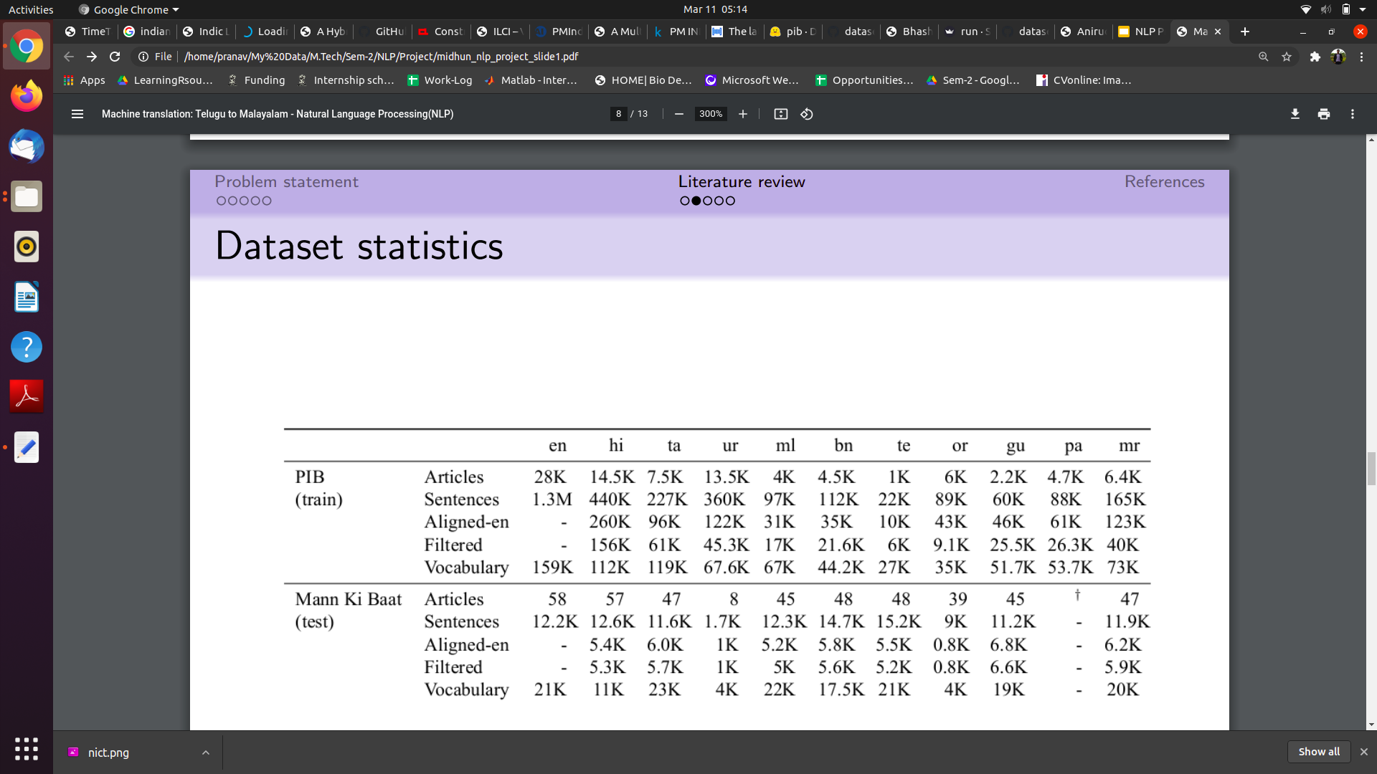
Dataset Stats

Slide 11
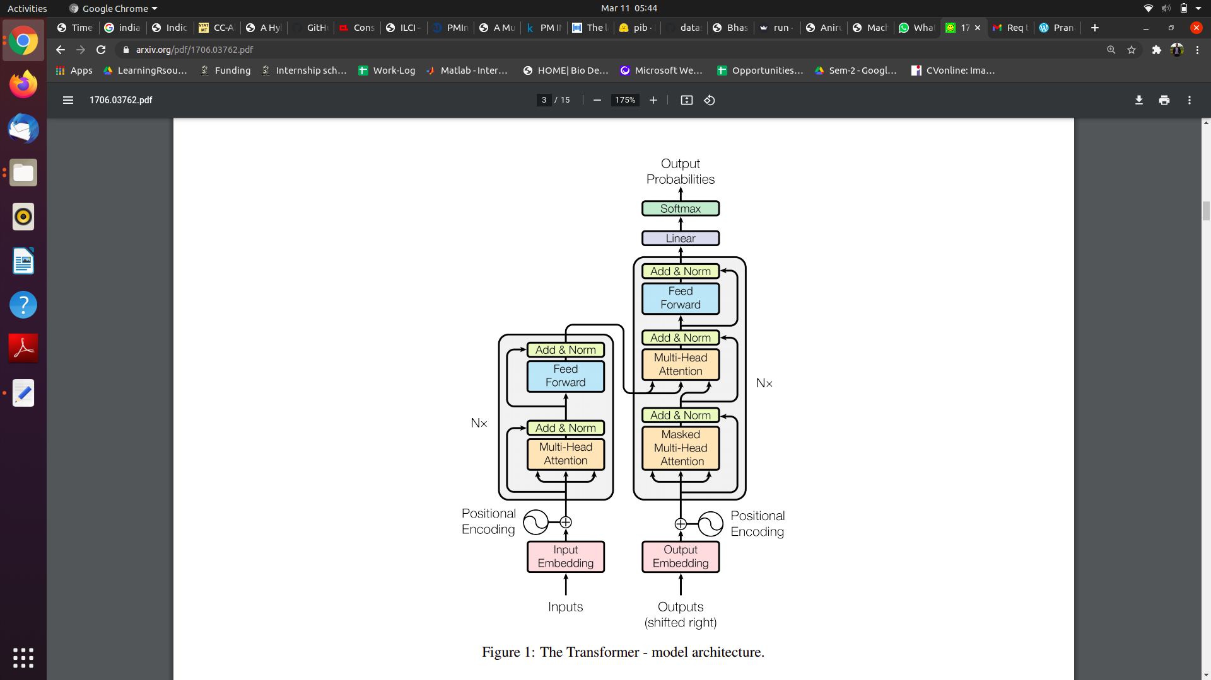
Proposed Methodology
Transformers [1] :

Slide 12
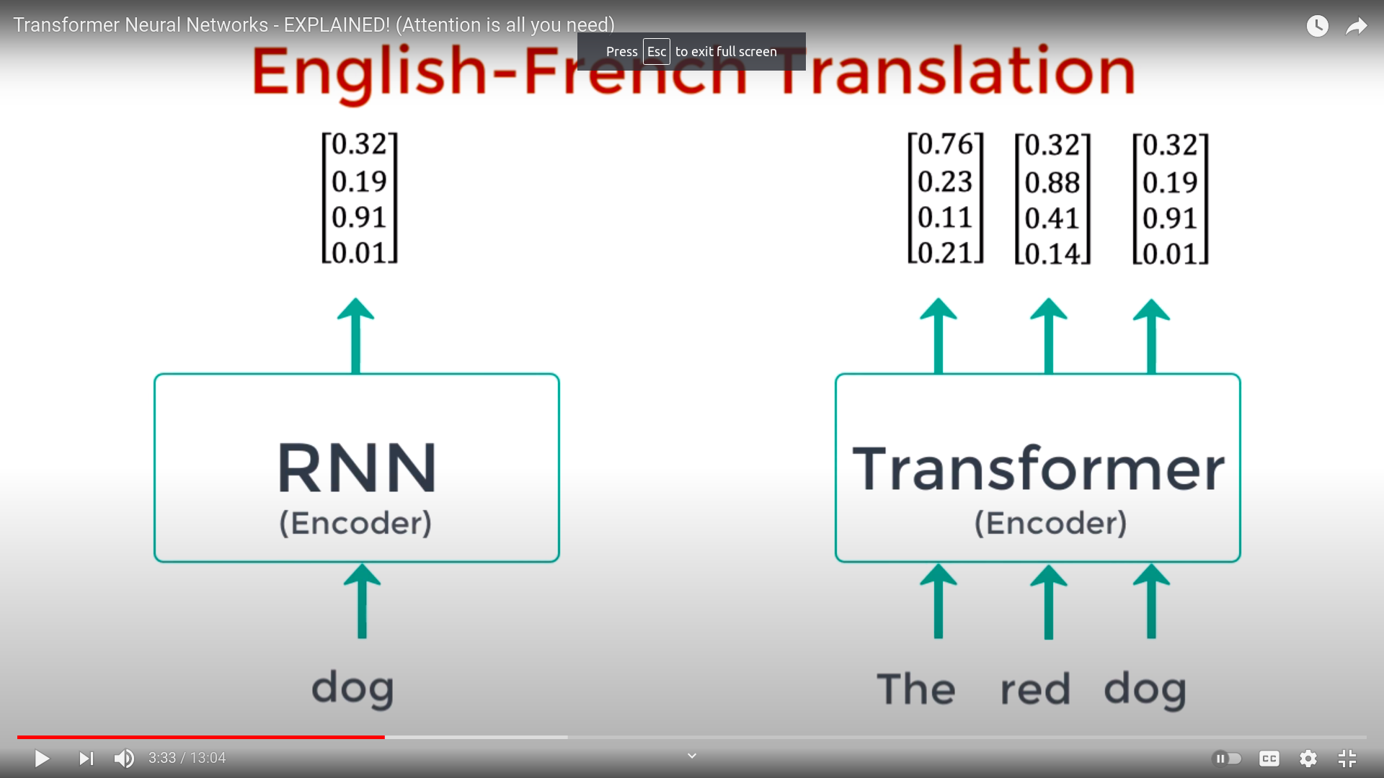
Proposed Methodology
Transformers [1] :

Slide 13
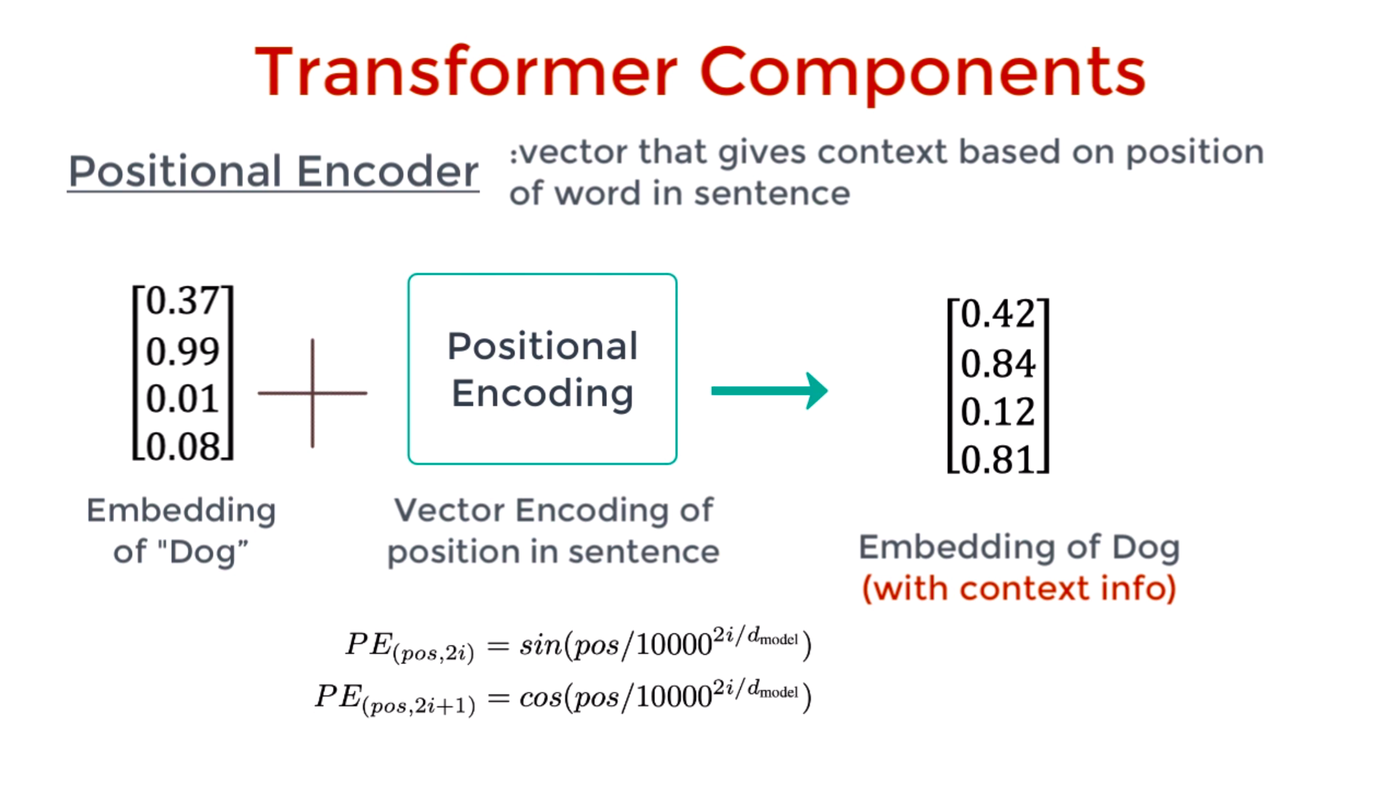
Proposed Methodology
Transformers [1] :

Slide 14
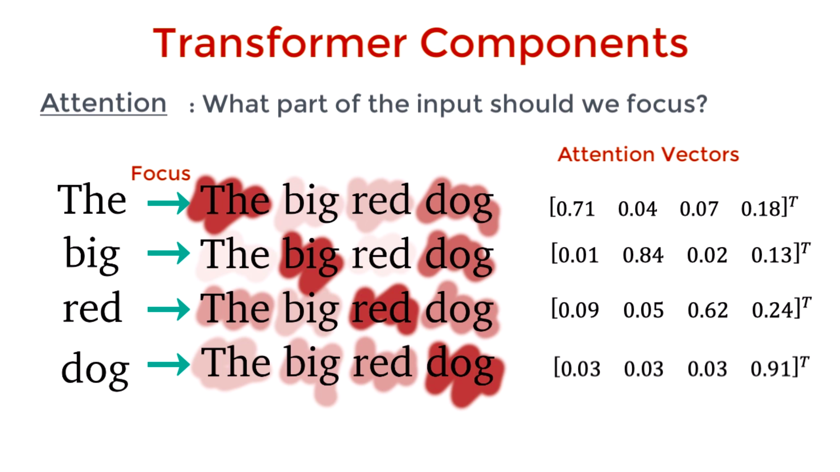
Proposed Methodology
Transformers [1] :

Slide 15
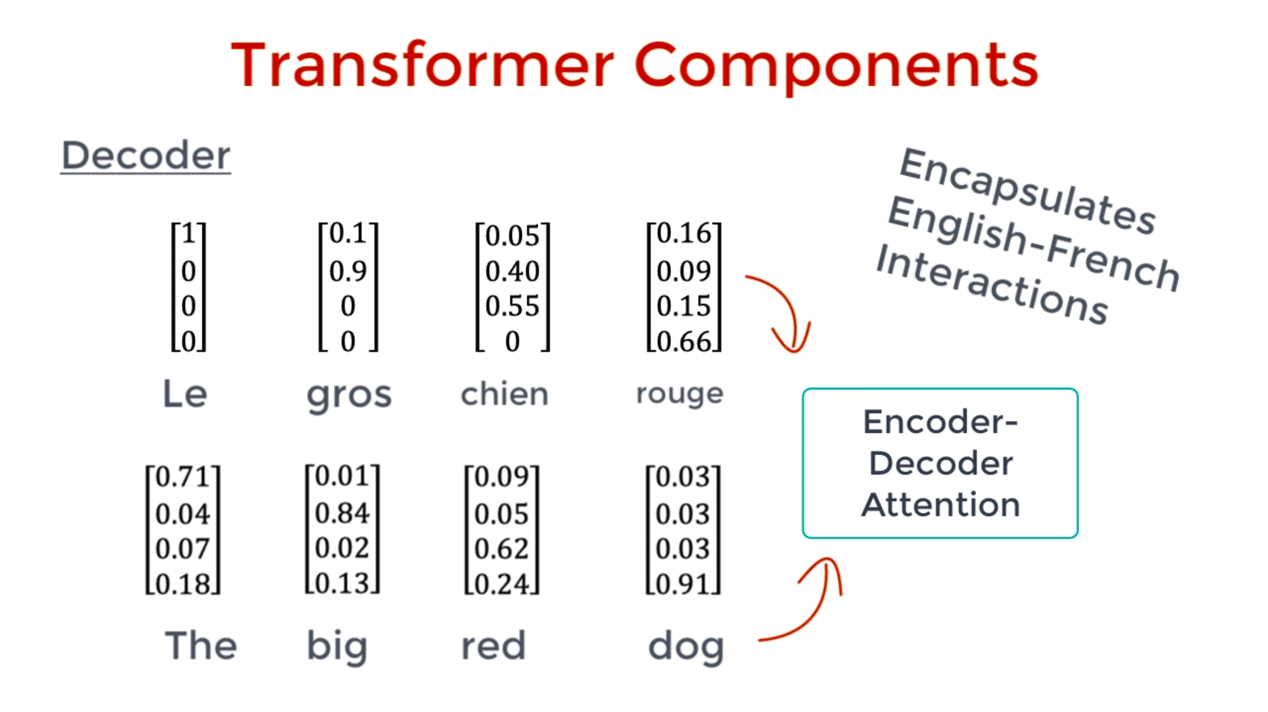
Proposed Methodology
Transformers [1] :

Slide 16
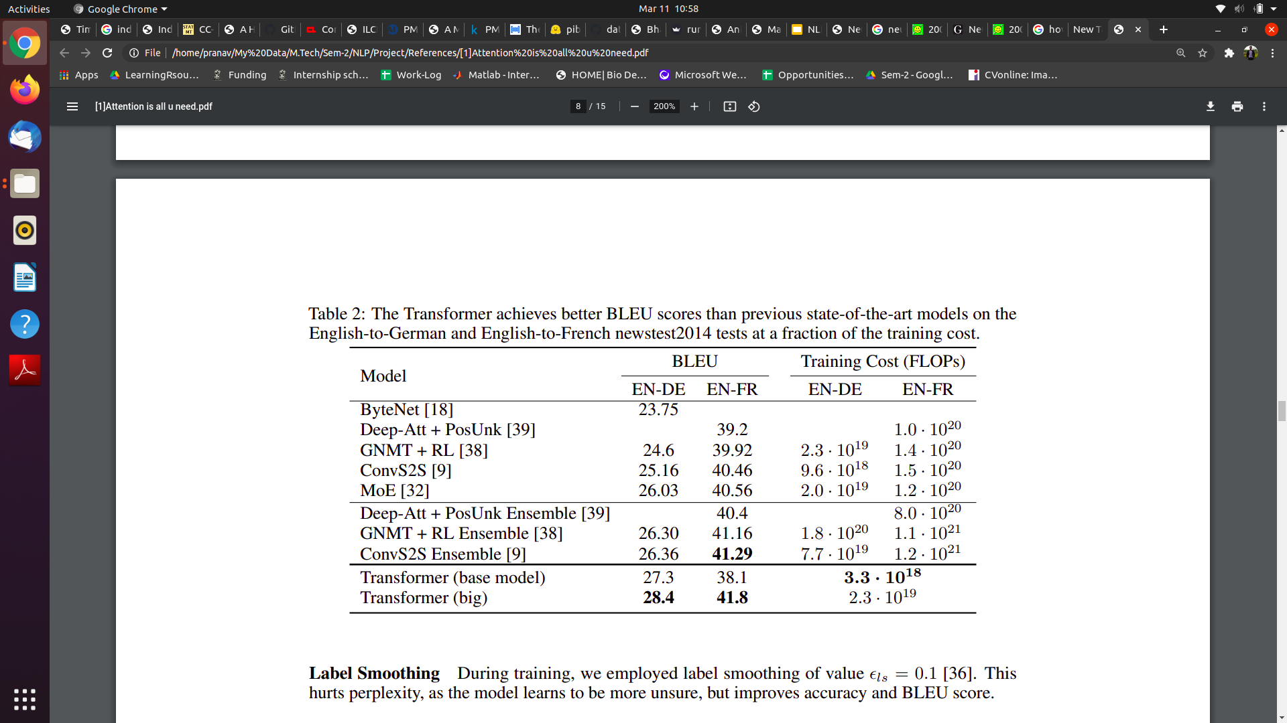
Proposed Methodology
Transformers [1] :
Results

Slide 17
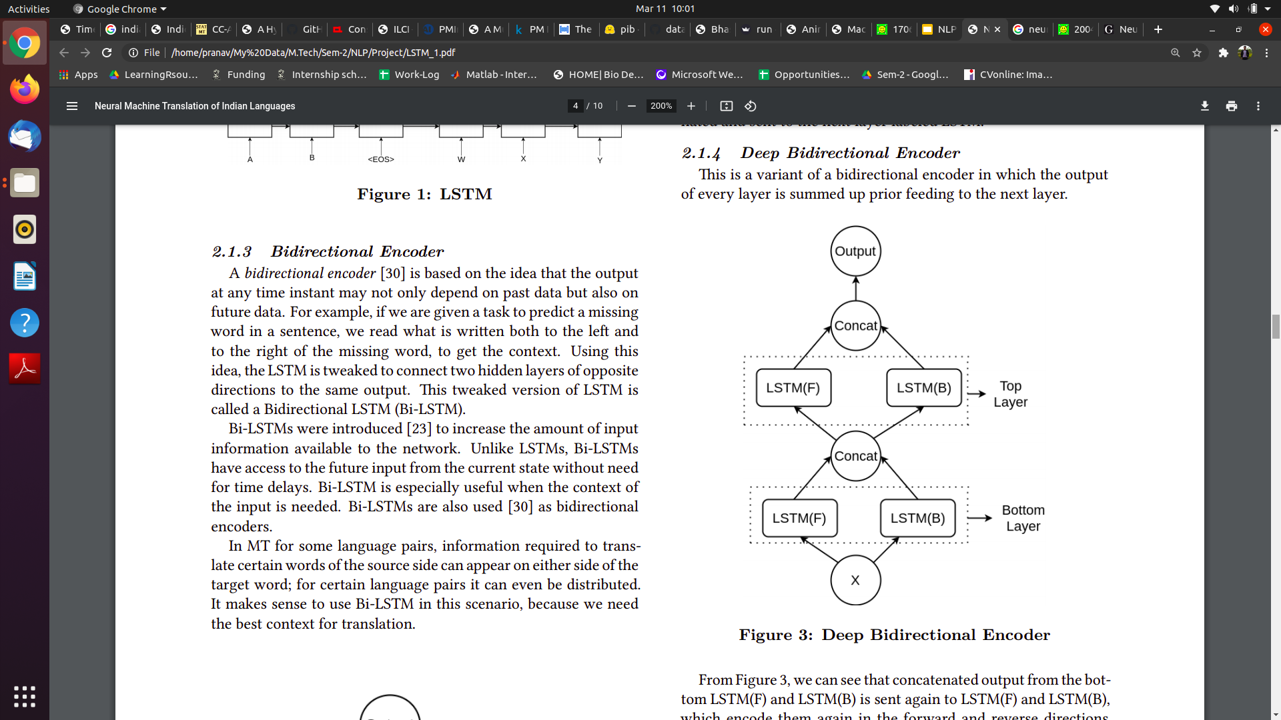
Proposed Methodology
2) Deep Bidirectional Encoder [2]:
This architecture looks at both the left side of the word and the right side of the word in the sentence while generating context.
This though sounds very similar to BERT, is slightly different as it does not use the concept of attention

Slide 18
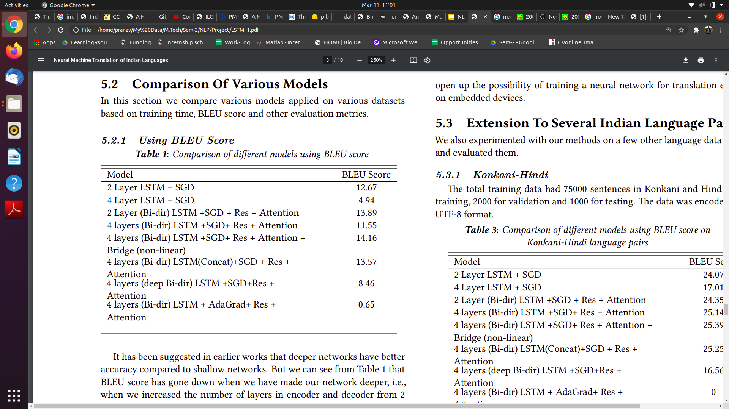
Proposed Methodology
2) Deep Bidirectional Encoder [2]:
Results

Slide 19
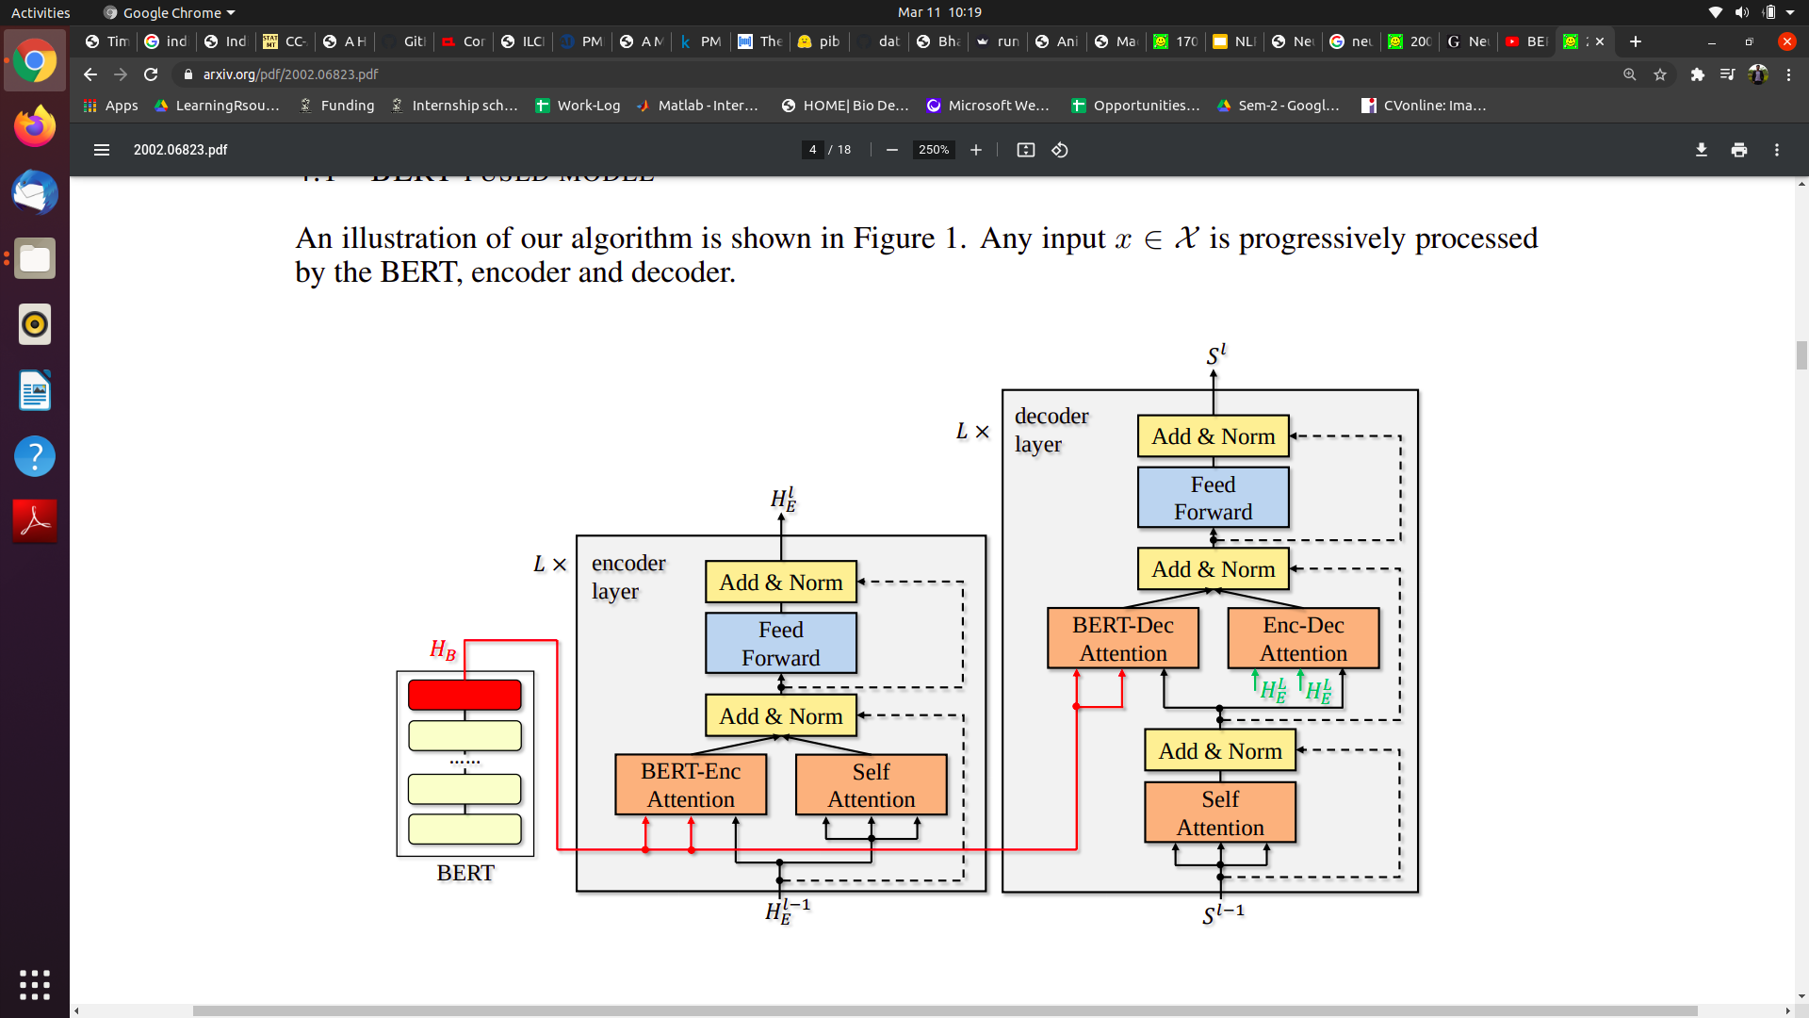
Proposed Methodology
3) BERT-fused model for NMT [3]:
BERT is first used to extract inputs for an input sequence.
Then, the representations are fused with each layer of the encoder and decoder of the NMT model through attention mechanisms.
Compared to standard NMT, in addition to BERT, there are two extra attention modules, the BERT-encoder attention and BERT-decoder attention.

Slide 20
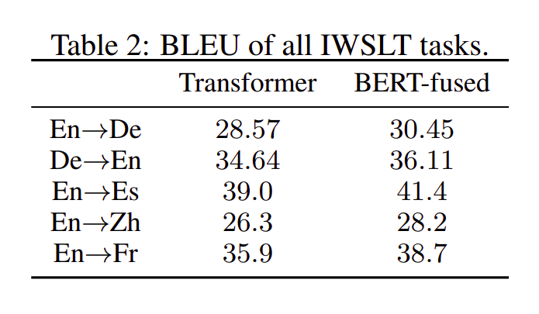
Proposed Methodology
3) BERT-fused model for NMT [3]:
Results

Slide 21
Bibliography(1/2)
[1] Vaswani, A., Shazeer, N., Parmar, N., Uszkoreit, J., Jones, L., Gomez, A. N., Kaiser, Ł., and Polosukhin, I. (2017). “Attention is all you need.” (In NIPS)
[2] Revanuru, Karthik & Turlapaty, Kaushik & Rao, Shrisha. (2017). Neural Machine Translation of Indian Languages. 10.1145/3140107.3140111.
[3] Jinhua Zhu1, Yingce Xia, Lijun Wu, Di He, Tao Qin, Wengang Zhou1, Houqiang Li, Tie-Yan Liu (2020) “INCORPORATING BERT INTO NEURAL MACHINE TRANSLATION” (ICLR)
[4] Himanshu Choudhary, Shivansh Rao, Rajesh Rohilla(April 2020). “Neural Machine Translation for Low-Resourced Indian Languages”.
[5] Siripragada, Shashank, et al. "A multilingual parallel corpora collection effort for Indian languages." arXiv preprint arXiv:2007.07691 (2020).
[6] Jacob Devlin, Ming-Wei Chang, Kenton Lee, and Kristina Toutanova. Bert: Pre-training of deep
bidirectional transformers for language understanding. NAACL, 2019.

Slide 22
Bibliography(2/2)
[7] Pathak, Amarnath and Pakray, Partha. "Neural Machine Translation for Indian Languages" Journal of Intelligent Systems, vol. 28, no. 3, 2019, pp. 465-477.
[8] Datasets:
PIB Corpus
PM Mann ki Baat
MultiIndicMT Dataset
CCAligned: A Massive Collection of Cross-lingual Web-Document Pairs ( Not sure if I’ll use this)

